Slide 1
BOOST (Better Operative Outcomes Software Tool)
Nathan Congdon
Queen’s University Belfast
Zhongshan Ophthalmic Center, Guangzhou, China
ORBIS International, NY, USA

Slide 2

Why is it important to measure cataract surgical quality?
Quality of surgery and resulting patient satisfaction are the engines that drive a sustainable cataract service
We must be able to measure quality before we can create it
Notes:
2

Slide 3
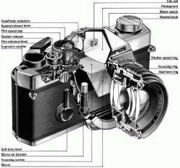

Why don’t we routinely measure cataract surgical outcomes?
Busy clinicians
Lack of resources and awareness about existing free options
Some available systems to record cataract outcomes offer very powerful functionality, but may be challenging for new users (“The SLR camera”)
Poor patient follow-up: How do we make sense of data with a range of different follow-up times?
Notes:
3
3

Slide 4
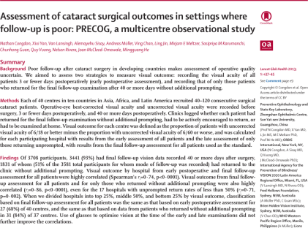
PRECOG project: Assessing cataract outcomes where follow-up is poor
40 hospitals in 12 countries (Asia, Africa, LAC)
4000 surgical cases, final outcomes recorded for > 90%
Notes:
4
4

Slide 5
Assessing cataract outcomes where follow-up is poor
rho = 0.74, P < 0.001
Validated two approaches to measuring quality when few patients return:
  Early assessment for ALL patients (First Day)
  Late (> 6 weeks) assessment of all those who DO return (even when rates <= 30%)
Late All
Early All
rho = 0.86, P < 0.001
Late All
Late Return
Notes:
5
5

Slide 6
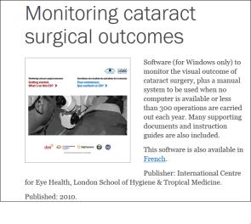
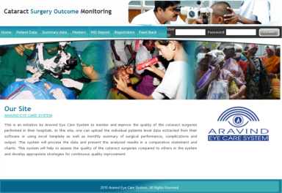
Existing software solutions
Some high-quality software systems exist to measure cataract surgical outcomes
  Monitoring software from ICEH, developed by Hans Limburg
  Aravind’s surgery outcome monitoring software
Notes:
6
6

Slide 7
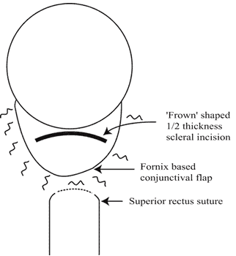
What is BOOST?
Unite behind a single cataract outcomes monitoring system
  Aravind, ICEH, NGOs, IAPB, ICO, WHO, end-users, etc.
Exploit the fact that earlier assessment of outcomes now practical due to widespread use of small incisions (SICS, phaco)
Notes:
7
7

Slide 8

What is BOOST?
Simple default settings:
  A “point and shoot” instead of an SLR
Capacity for more powerful, flexible functionality as needed
Quick to download, can be used offline
Vision 2020
Vision 2020
Notes:
8
8

Slide 9
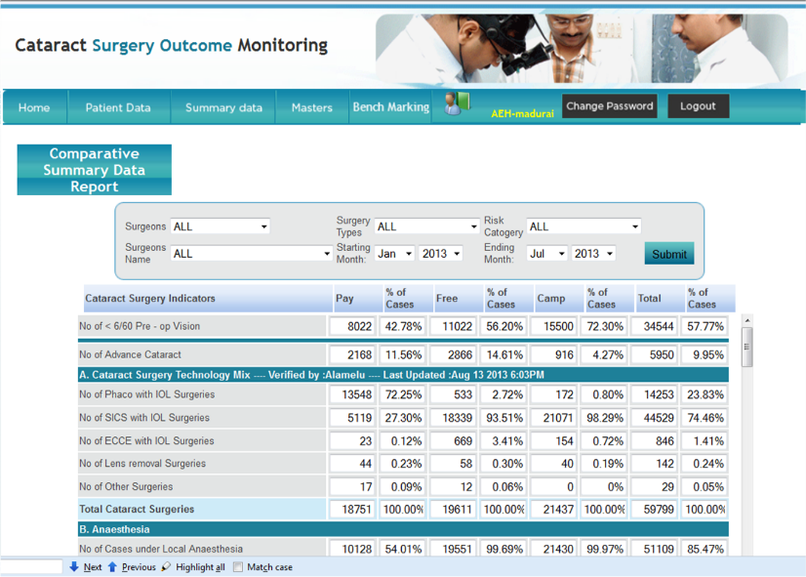
What is BOOST?
Following protocol validated in PRECOG, system will automatically step the user through collection of the minimum data set needed to:
  Assess existing outcome quality (60 consecutive cases, post-op day #1)
Notes:
9
9

Slide 10
What is BOOST?
Identify and suggest measures to correct principal cause of poor outcomes (20 cases with VA < 6/60 at 6 weeks)
  Surgical complications
  Inappropriate case selection (co-morbidities)
  Refractive error/inaccurate IOL power
Notes:
10
10

Slide 11

What is BOOST?
The system will be based on a stable platform for long-term use
  Aravind
NGOs, IAPB, WHO, partners institutions, etc., will join together to:
  Support development of the system
  Support long-term maintenance
  Advertise and promote universal, free access by download from websites everywhere: the “Angry Birds” of eye health!
Notes:
11
11

Slide 12
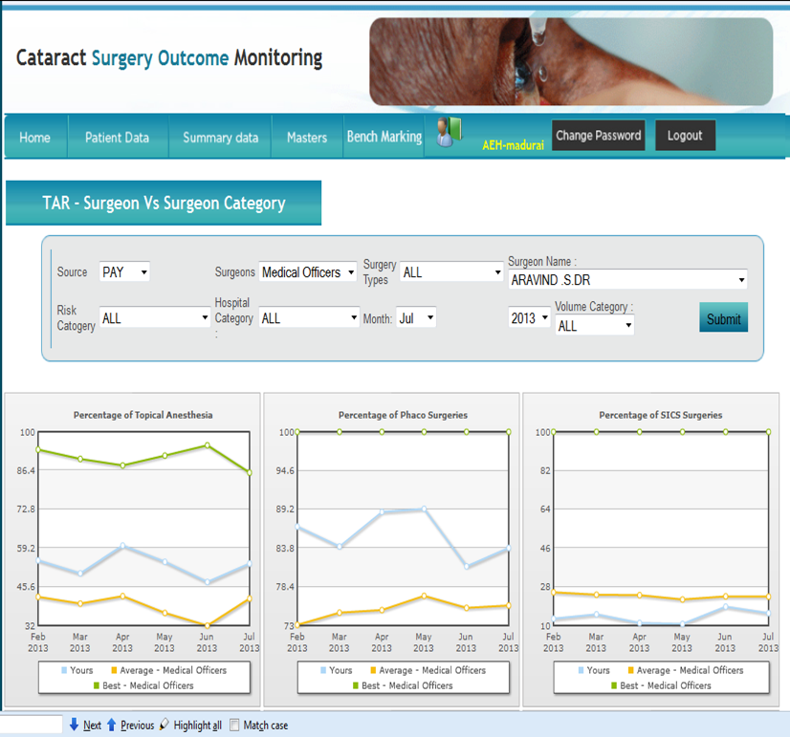
What is BOOST?
Cloud-based database
Password-protected user accounts, user decides who sees their data
Will exist as a de novo, cross-platform app, strong input on design from ICEH and Aravind
Notes:
12
12

Slide 13
Progress to Date
Marketing survey at 90 hospitals in Africa, Asia, LAC, Pacific:
  Strong support (90%) for sharing data anonymously in cloud
  Strong demand for continuous (not one off) use, and for functionality both to measure and improve quality
Notes:
13
13

Slide 14
Progress to Date
Completion of Windows version at Aravind
Identification of programmers and funding sought to migrate to Android platform
Preparation for formal field testing:
  Original PRECOG Cohort and market survey institutions
  Letter in Lancet Global Health seeking additional testing institutions
Notes:
14
14

Slide 15

Improving Cataract
Surgical Quality
The road to improving cataract surgical quality is a long one
  Many institutions have not even started the journey due to lack of a car
  We propose to provide a robust, simple, high-quality bicycle
Notes:
15
15

Slide 16



Thank You
Vision 2020

